Slide 1

ACM Project
WEEK - 1 Assignment
Dataset used: udemy courses dataset, Linkedin top skill dataset, stackoverflow developers survey dataset
Team Leader : Vaibhav Bhatt

Slide 2
Representations used in graphs:
Business finance = 0
Musical Instruments =1
Graphic design = 2
Web development = 3
All Level courses = 0
Beginner level courses =1
Intermediate level courses =2
Expert level courses = 3
Paid = 1
Non paid = 0

Slide 3
Major Conclusion from the CSV File
There are courses containing no lectures as well as no content duration
Content duration and number of lectures at 75th percentile are only 4.5 hrs and 26 while their maximum is 78.5 and 779
Number of subscribers at 75th percentile is 2548.75 while its maximum is 268923.0
Number of reviews at 75th percentile are 67 while its maximum is 27445
Maximum price of any course is 200
There are courses with 0 subscribers
Maximum content duration is 78.5 hrs

Slide 4
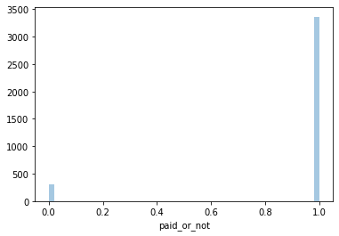
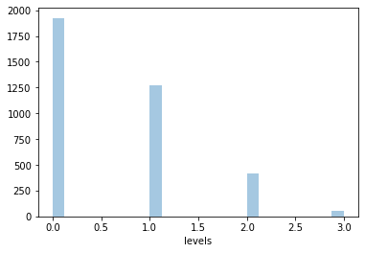
Analysis on the basis of Categorical Data
The number of paid courses are much higher than non_paid courses.
Number of "All levels" courses are much higher than "Expert Level" courses followed by "Beginner level" courses .

Slide 5
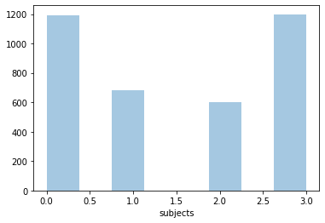
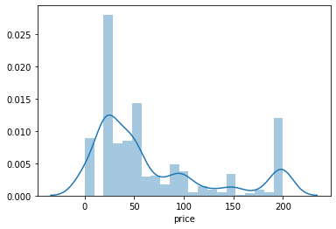
Number of "Web Development" and "Business Finance" courses are comparable and higher than the other two
Most of the courses have price range between 0-50

Slide 6
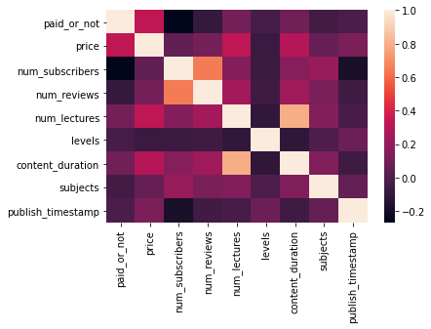
Heatmap

Slide 7
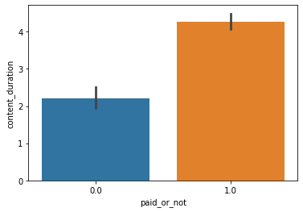
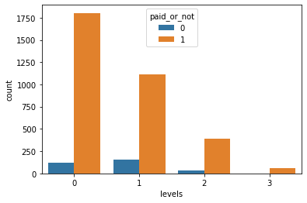
Analysis on Data Distribution by paid and non-paid courses
There are no non paid courses for "expert level" courses .
Average content duration of paid courses is more than unpaid
Most of the paid courses are “All level” courses

Slide 8
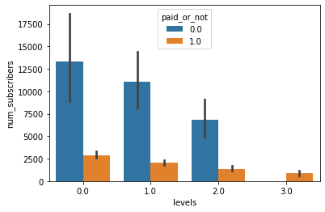
While paid courses are much more than non paid courses (almost 10 times in number), the average number of subscribers in non paid courses are more(11533 vs 2421) .
Maximum number of subscribers in non paid courses are 268923 more that is double the number of paid courses 121584 .
Number of subscribers in the non paid courses with "All level" courses are most .

Slide 9
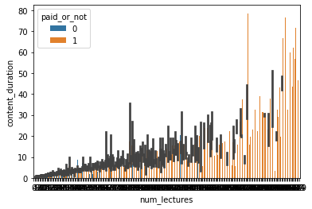
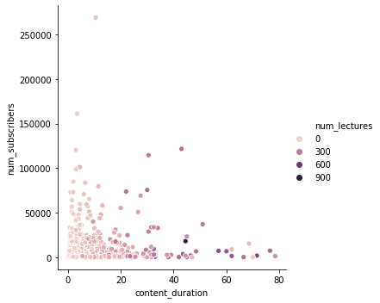
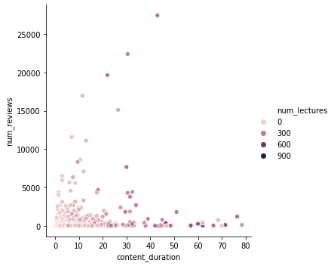
Analysis on the basis of Content Duration and Number of Lectures
In general content duration increases as number of lectures increases
Distribution of number of reviews and subscribers are more towards less content duration

Slide 10
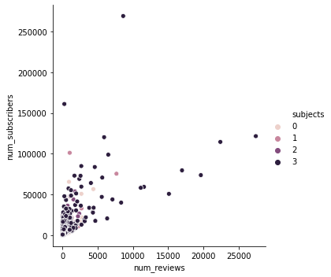
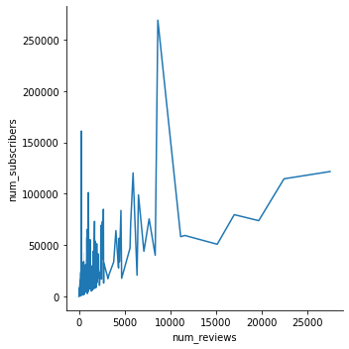
Effect of number of views on the number of subscribers
According to heatmap number of reviews has the most effects on subscribers
We can see that generally as the number of reviews increase the number of subscribers also increase
Most courses with large number of subscribers are web development courses

Slide 11
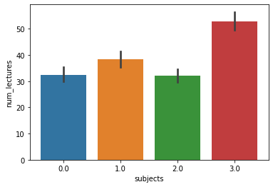
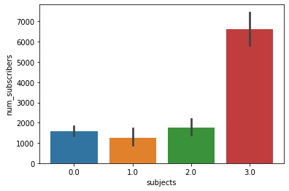
Analysing data on the basis of subject
Web development courses have the most number of subscribers
Web development courses have the highest number of lectures.

Slide 12
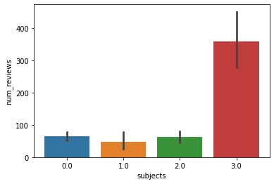
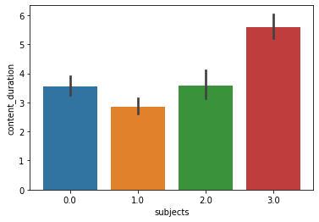
Web Development courses have most number of reviews.
Web Development courses have highest content duration.

Slide 13
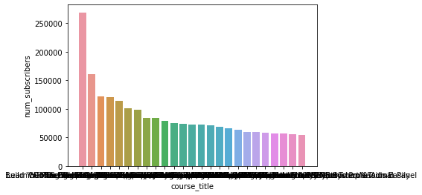
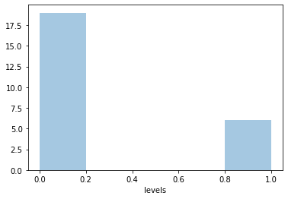
Analysing top 25 courses with more number of subscribers
Interestingly 80% of the top 25 courses are web development courses while musical instrument courses and business courses are 8% and rest are graphic designing courses.
76% of the courses are of "All level" courses while rest are "Beginner level" courses. No other levels are available .

Slide 14
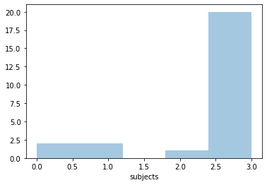
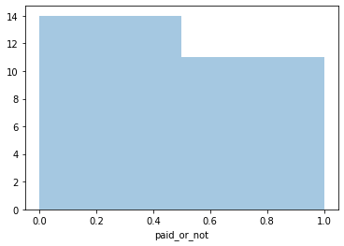
Out of them 44 % are paid and 56 % are unpaid .

Slide 15
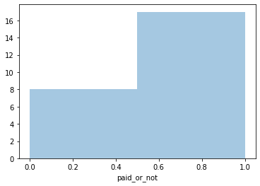
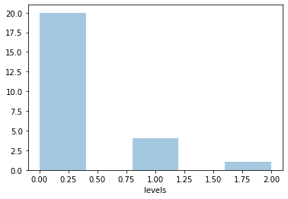
Analysing top 25 courses with most number of reviews
Out of them 68% are paid and 32% are unpaid .
80% of the courses are of "All level" courses while 16% "Beginner level" courses and rest 4% are "Intermediate level" .

Slide 16
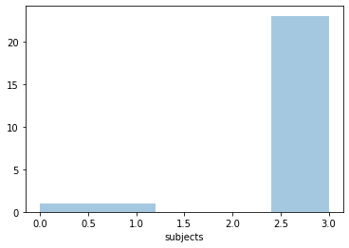
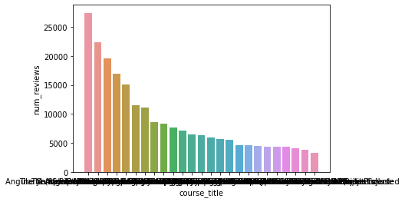
Interestingly 92 % of the top 25 courses with most reviews are web development courses while musical instruments courses and business courses are 4 % each , no Graphic designing course is in the list.

Slide 17
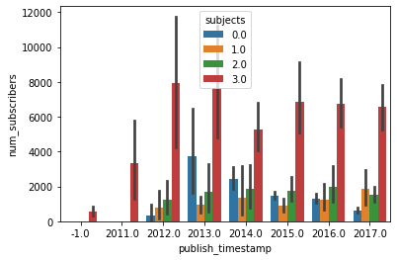
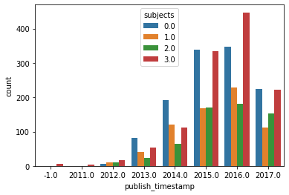
Analysis on courses over years
Number of courses have increased quite heavily from 2011 to 2016, while we saw decrement in the number of courses in 2017
Number of subscribers of business courses have increased from 2012 to 2013 and decreasing since.
Web development subscribers trends in decreasing over the years since 2012.
Designing courses also saw a decreasing trends in subscribers since 2013

Slide 18
Correlating data with external source
It is evident from the data that Web Architecture and Development Framework is becoming more and more popular in the recent years according to the top skills dataset by LinkedIn. While it overpasses Business Intelligence and SEO/SEM Marketing after 2015, User Interface Design is gaining more and more popularity. Web Architecture and Development Framework was listed at fourth in the top skills of 2018. This is similar to the data we have seen from udemy which infers that web development courses are more popular than any other courses evidenced from their high frequency, more subscribers, and more reviews.
Correlation with LinkedIn top skills dataset

Slide 19
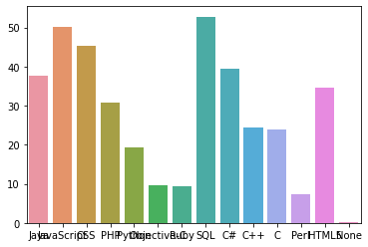
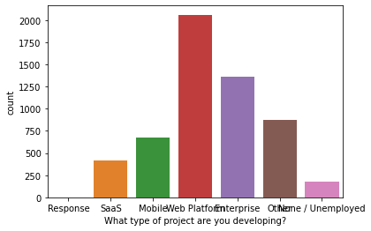
2. Stackoverflow developers survey dataset
According to developers survey 2012 by stackoverflow, javascript was second most skilled language in terms of developer proficiency. over 3128 people had proficiency in javascript. over 2060 developers were working on a project related to web platform which topped the list among other projects.

Slide 20
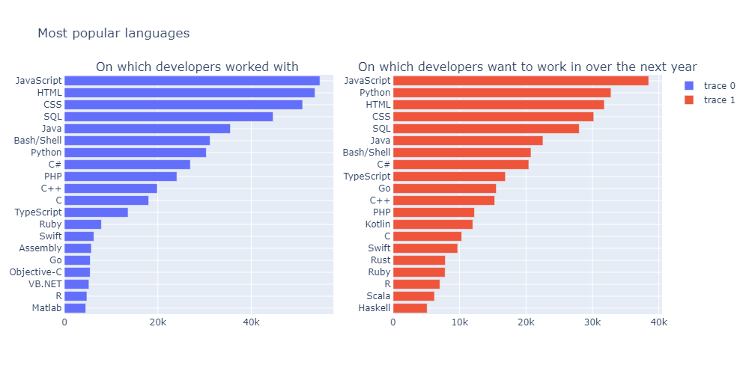
According to developers survey 2018 by stackoverflow, javascript,html,css were the most popular language developers worked with, while most of the developers said they want to work with javascript,python,html,css in future.
This indeed reflects to the all along popularity of web-development among developers which correlates to the increase in web development courses over the years.

Slide 21

THANK YOU

